Slide 1





IMDB
MOVIE ANALYSIS
Mohak Shah

Slide 2

INTRODUCTION
Objective: Analyze factors influencing the success of movies based on IMDB scores.
Significance:
        Helps producers, directors, and investors make informed decisions.
        Identifies trends that drive higher ratings and financial success.
Dataset Overview:
Records on genres, duration, languages, directors, budgets, and more.

Slide 3
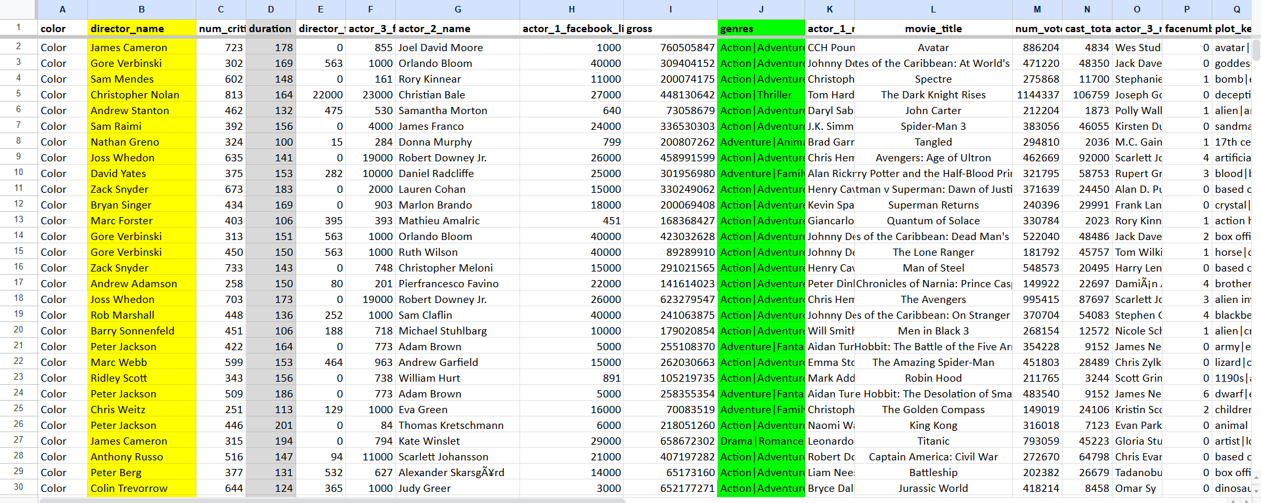
DATASET

Slide 4
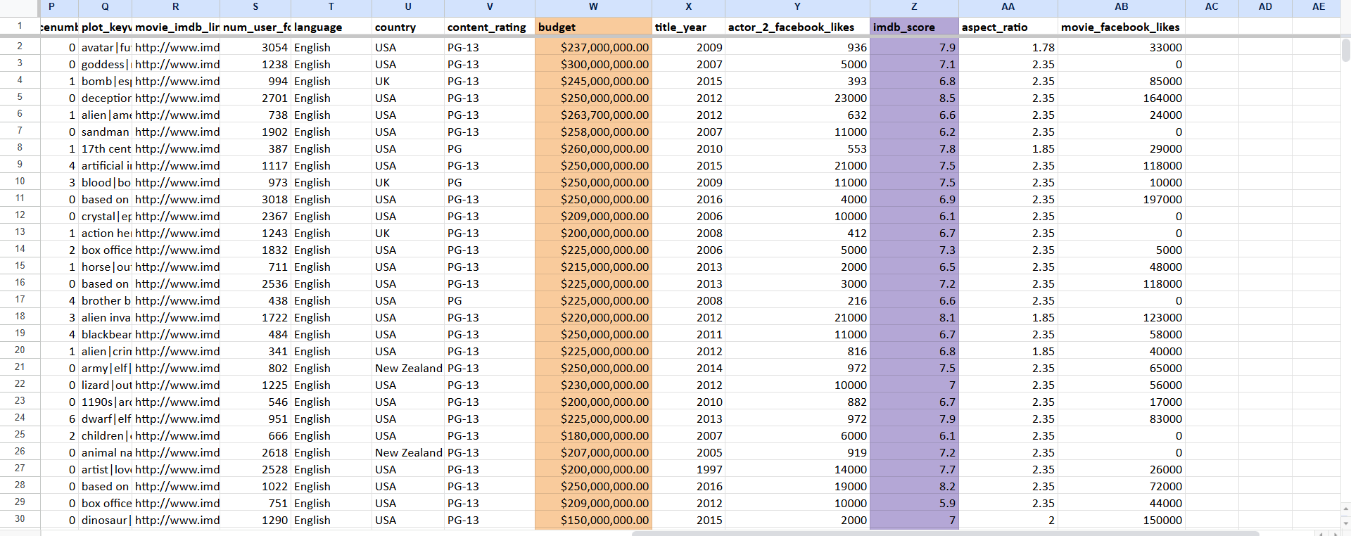
DATASET

Slide 5

DESCRIPTION
A potential problem to investigate could be: "What factors influence the success of a movie on IMDB?" Here, success can be defined by high IMDB ratings. The impact of this problem is significant for movie producers, directors, and investors who want to understand what makes a movie successful to make informed decisions in their future projects..

Slide 6

Task Overview
Movie Genre Analysis
Movie Duration Analysis
Language Analysis
Director Analysis
Budget Analysis

Slide 7
Task Overview
Movie Genre Analysis
Movie Duration Analysis
Language Analysis
Director Analysis
Budget Analysis

Slide 8
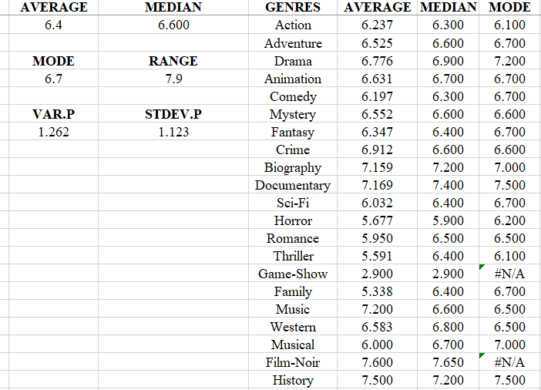
Movie Genre Analysis
Objective: Analyse how genres affect IMDB scores.
Methodology:
                Identify unique genres.
              Compute descriptive statistics for each genre
                (mean, median, variance).
              Compare average scores across genres.
Key Insight: Genres like Film-Noir tend to perform better with higher average ratings.

Slide 9
Task Overview
Movie Genre Analysis
Movie Duration Analysis
Language Analysis
Director Analysis
Budget Analysis

Slide 10
Task Overview
Movie Genre Analysis
Movie Duration Analysis
Language Analysis
Director Analysis
Budget Analysis

Slide 11
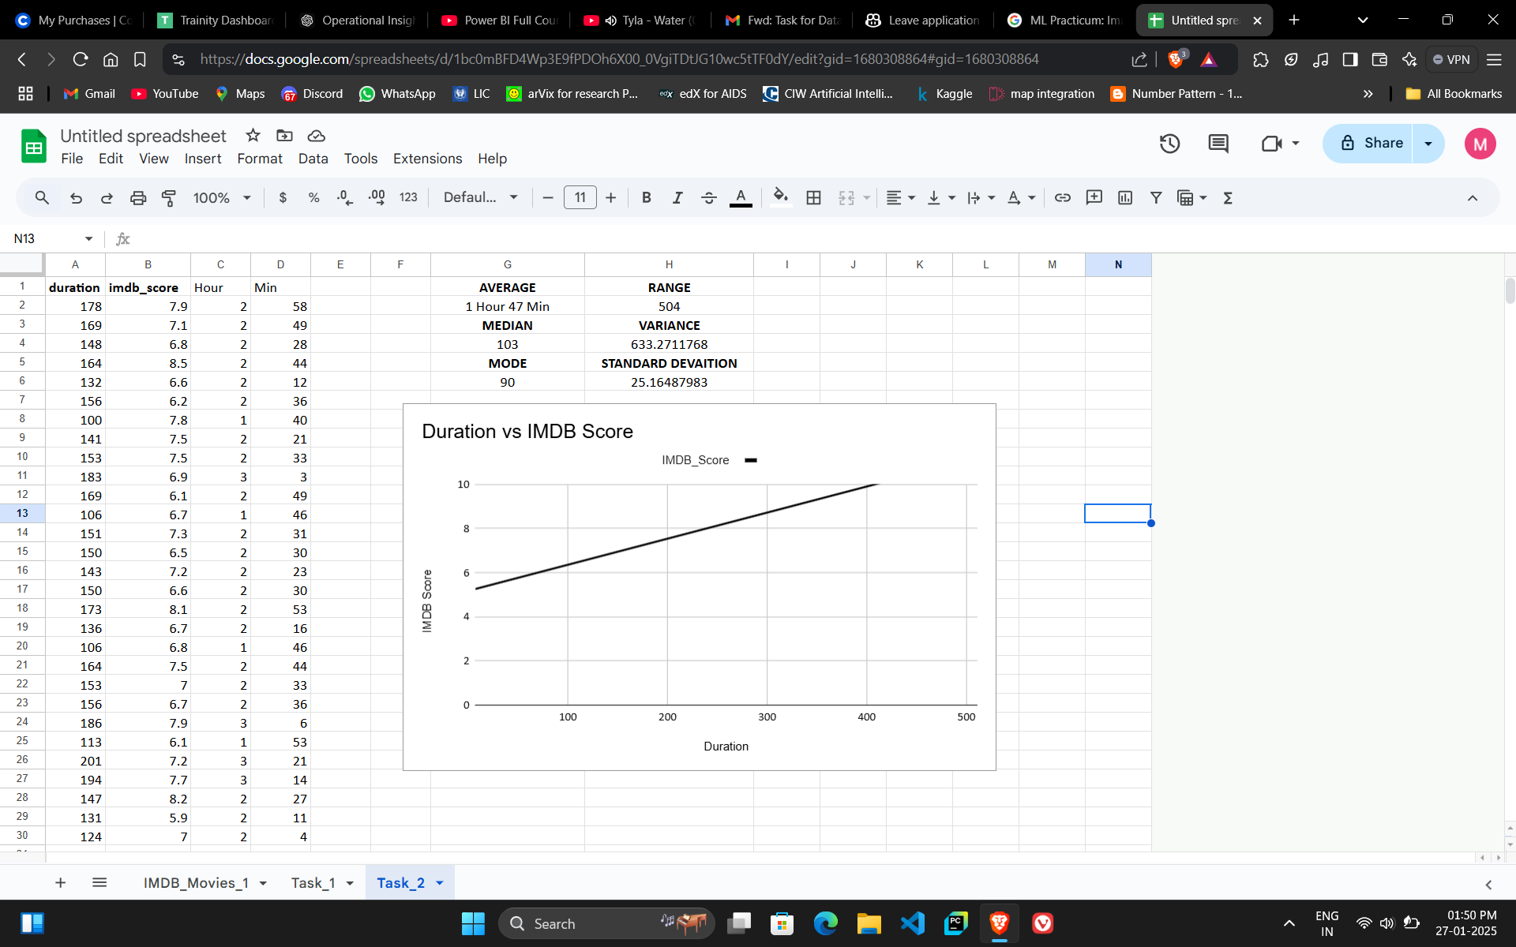
Movie Duration Analysis
Objective: Investigate the relationship between movie duration and IMDB scores.
Methodology:
                Calculate descriptive statistics (mean, median, standard deviation) for duration.
                Convert duration into hours and minutes.
                Create a scatter plot of duration vs. IMDB score with a trendline.
Key Insight: Movies with durations between 1 hour 47 min are rated higher on average.

Slide 12
Task Overview
Movie Genre Analysis
Movie Duration Analysis
Language Analysis
Director Analysis
Budget Analysis

Slide 13
Task Overview
Movie Genre Analysis
Movie Duration Analysis
Language Analysis
Director Analysis
Budget Analysis

Slide 14
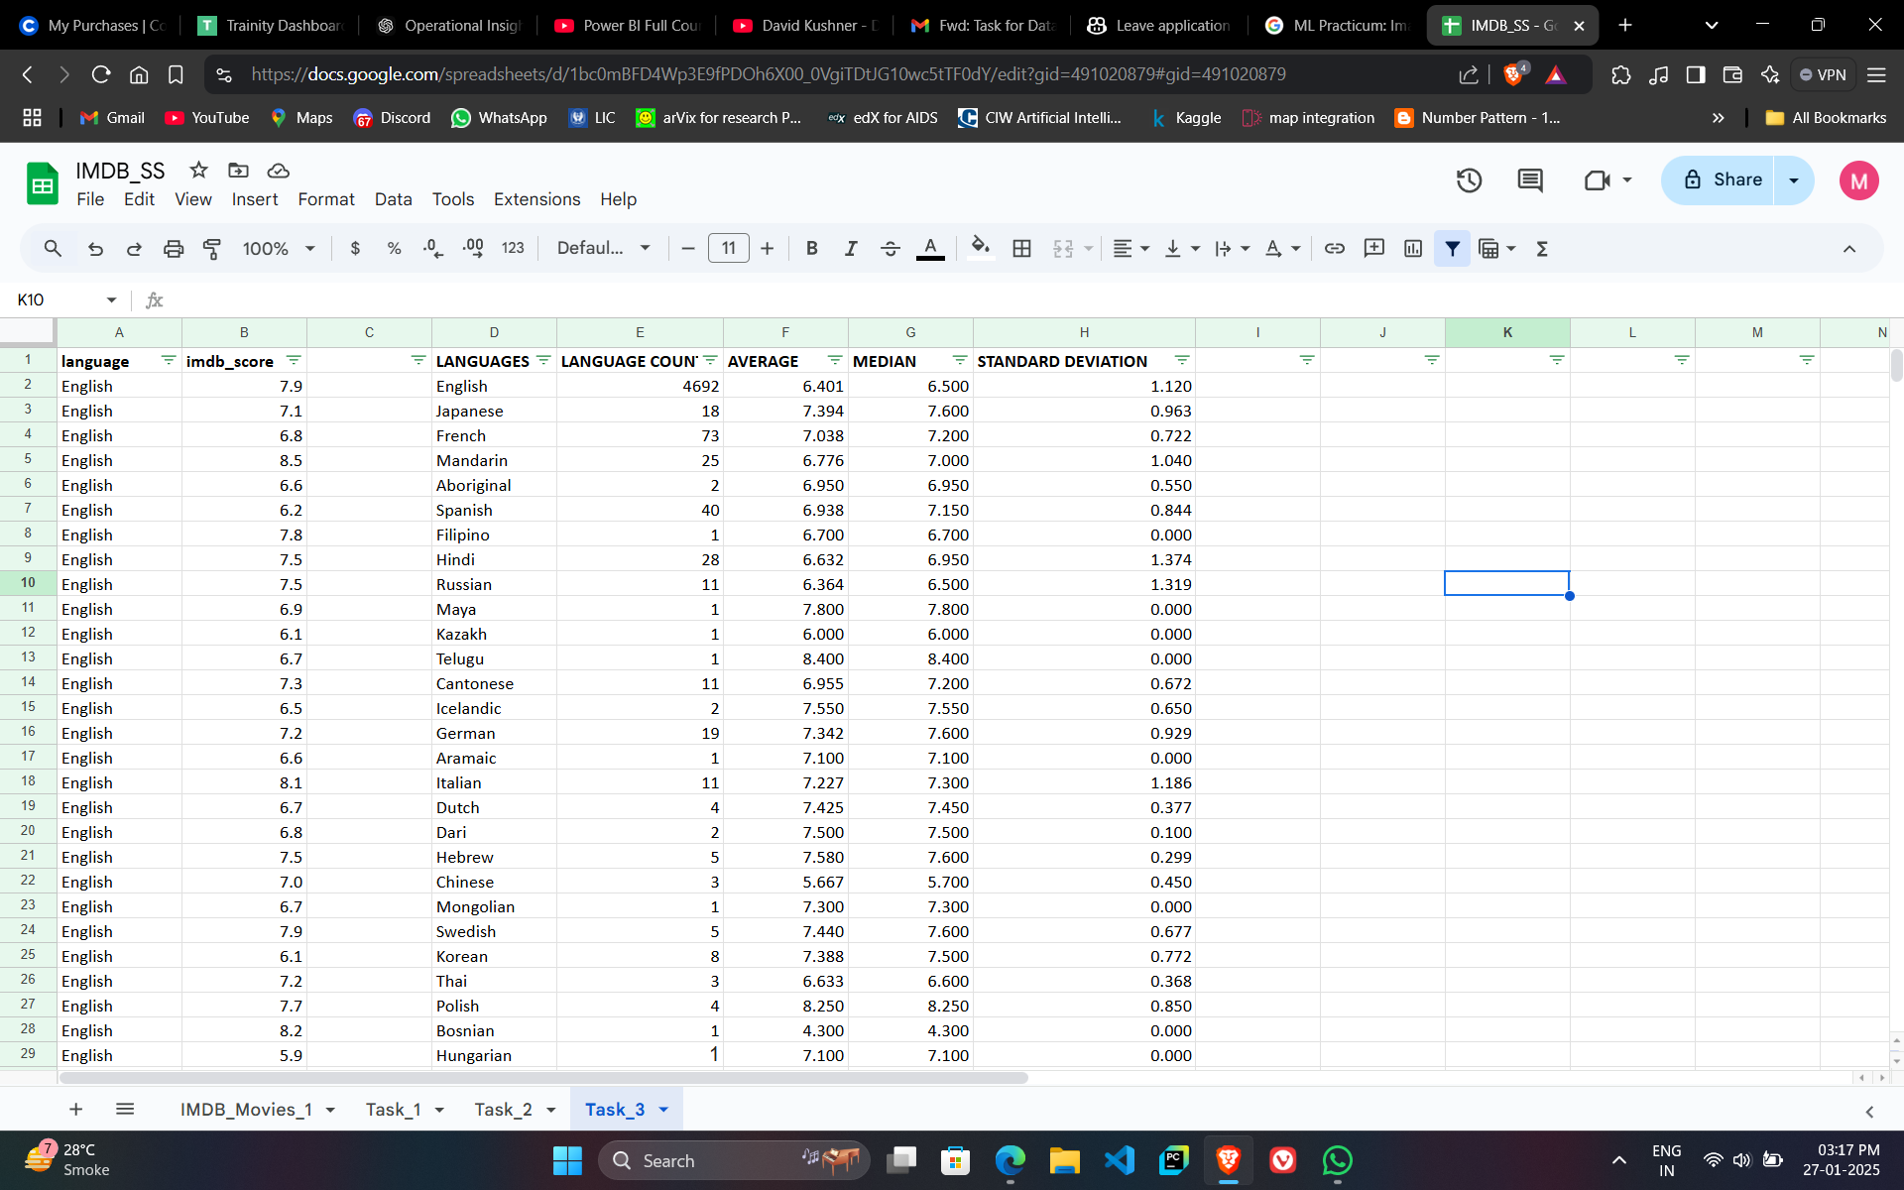
Language Analysis
Objective: Investigate the relationship between movie language and IMDB scores.
Methodology:
                Identify unique languages in the dataset.
                Use COUNTIF to find the frequency of each language.
                Compute the mean IMDB score for movies in each language.
Key Insight: English is the most frequent, while Telugu has the highest average score.

Slide 15
Task Overview
Movie Genre Analysis
Movie Duration Analysis
Language Analysis
Director Analysis
Budget Analysis

Slide 16
Task Overview
Movie Genre Analysis
Movie Duration Analysis
Language Analysis
Director Analysis
Budget Analysis

Slide 17
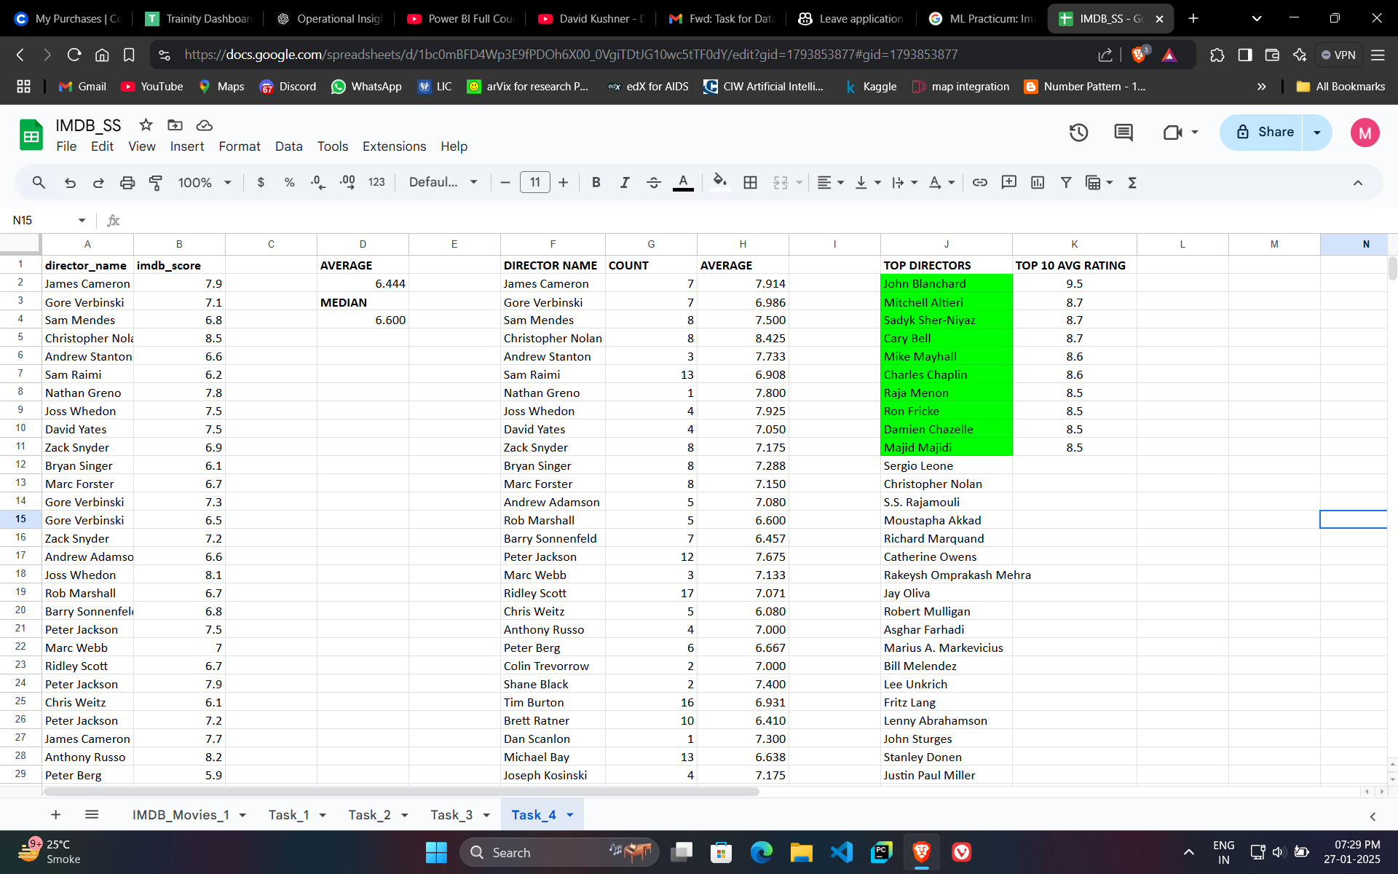
Director Analysis
Objective: Understand the influence of directors on movie success.
Methodology:
                Calculate the average IMDB score for each director.
                Identify top-performing directors using percentile calculations.
                Compare top director’s scores with the overall distribution.
Key Insight: Directors like John Blanchard consistently produce highly rated movies.

Slide 18
Task Overview
Movie Genre Analysis
Movie Duration Analysis
Language Analysis
Director Analysis
Budget Analysis

Slide 19
Task Overview
Movie Genre Analysis
Movie Duration Analysis
Language Analysis
Director Analysis
Budget Analysis

Slide 20
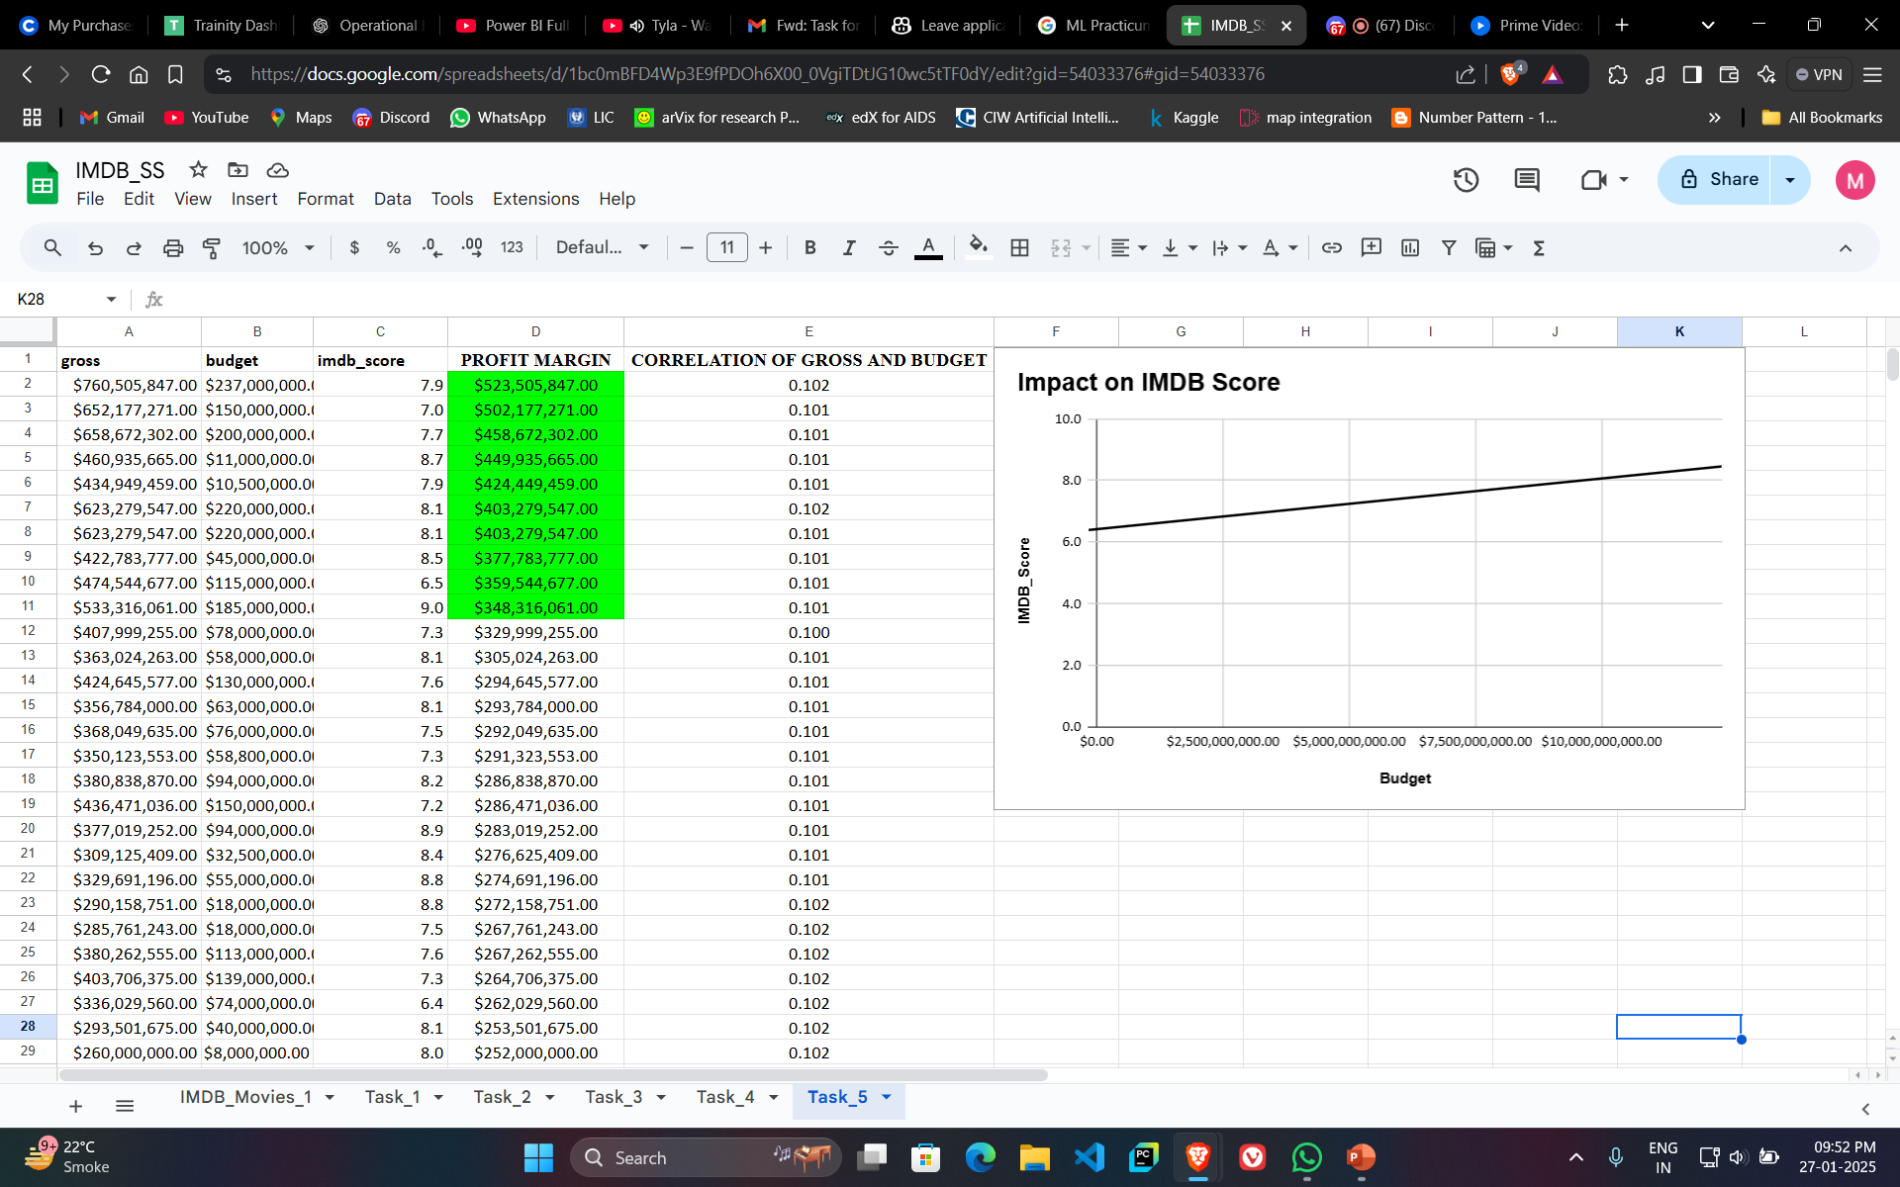
Budget Analysis
Objective: Explore the relationship between budgets, gross earnings, and profit margins.
Methodology:
                Calculate profit margin as gross - budget.
                Compute the correlation coefficient between budget and gross earnings.
                Identify movies with the highest profit margins.
                Create a scatter plot of budget vs. IMDB score.
Key Insight: Movies with budgets 50M show the highest return on investment.

Slide 21
Key Insights
Genre Preference: Film-Noir has the highest average IMDB score.
Optimal Duration: Movies within 1 hour 47 min duration tend to perform better.
Language Impact: Telugu is both popular and highly rated.
Director Influence: Top directors significantly affect movie success.
Budget Efficiency: Higher budgets correlate positively with gross earnings but not always with IMDB scores.

Slide 22

Thank You!
IMDB Movie Analysis

